Slide 1
Adam Smith, Andrew Carnegie, John Rawls: Income Inequality and the Occupy Movement
Dr. Alan Haffa

Slide 2
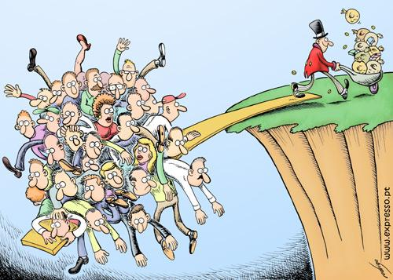
Questions to Generate Dialogue
1) Is Income Inequality Growing Worse?
2) Does it matter? Why or why not?
3) How do Smith, Carnegie and Rawls answer the question?
4) What is the Occupy Movement proposing we do about Income Inequality?

Slide 3
How can we Measure or Evaluate Income Inequality?
Income vs. Wealth
How does the Income Differential between the 1% of highest earners compare to the other 99%?
What kind of social mobility is possible today compared to the past? (The American Dream)

Slide 4
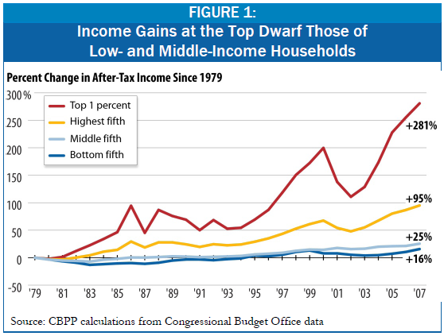
Income Gains: http://www.theatlantic.com/business/archive/2011/10/income-inequality-is-not-a-myth/247389/
Notes:
CBPP: Center on Budget and Policy Priorities, a non-profit

Slide 5
Conclusion by Woolf
“Examination of the data on the wealth distribution leads to a disturbing question: Is America still the land of opportunity? The growing divergence evident in the income distribution is even starker in the wealth distribution. Equalizing trends during the 1930s through the 1970s reversed sharply in the 1980s. The gap between haves and have-nots is greater now – at the start of the twenty-first century – than at any time since 1929.”
Economist Edward N. Wolff, “Top Heavy: The Increasing Inequality of Wealth in America and What Can Be Done About It”

Slide 6
Adam Smith: The Invisible Hand
(Liberal) As little government interference as possible; low taxes lead to more productivity.
Invisible Hand: people’s individual economic choices naturally lead to the best possible economy
Free Trade will lead to economic benefits for all parties

Slide 7
The Invisible Hand
“As every individual, therefore, endeavours as much as he can both to employ his capital in the support of domestic industry, and so to direct that industry that its produce may be of the greatest value; every individual necessarily labours to render the annual revenue of the society as great as he can. He generally, indeed, neither intends to promote the public interest, nor knows how much he is promoting it. By preferring the support of domestic to that of foreign industry, he intends only his own security; and by directing that industry in such a manner as its produce may be of the greatest value, he intends only his own gain, and he is in this, as in many other cases, led by an invisible hand to promote an end which was no part of his intention. Nor is it always the worse for the society that it was no part of it. By pursuing his own interest he frequently promotes that of the society more effectually than when he really intends to promote it.” Wealth of Nations, Part IV, Chapter 2, p. 423.

Slide 8
Trade Associations influence on Government
“to widen the market and to narrow the competition, is always the interest of the dealers…The proposal of any new law or regulation of commerce which comes from this order, ought always to be listened to with great precaution…It comes from an order of men, whose interest is never exactly the same with that of the public, who has generally an interest to deceive and even to oppress the public…” (p. 250)

Slide 9
Smith on Equity
“Is this improvement in the circumstances of the lower ranks of the people to be regarded as an advantage or as an inconveniency to the society?...but what improves the circumstances of the greater part can never be regarded as an inconveniency to the whole. No society can surely be flourishing and happy, of which the far greater part of the members are poor and miserable. It is but equity, besides, that they who feed, clothe and lodge the whole body of the people, should have such a share of the produce of their own labor as to be themselves tolerably well fed, clothed, and lodged.” (p. 79)

Slide 10
Smith on Bank Regulation
“To restrain private people, it may be said, from receiving in payment the promissory notes of a banker, for any sum whether great or small, when they themselves are willing to receive them; or, to restrain a banker from issuing such notes…is a manifest violation of that natural liberty which it is the proper business of law, not to infringe, but to support….but those exertions of the natural liberty of a few individuals, which might endanger the security of the whole society, are, and out ought to be, restrained by the laws of all governments;…The obligation of building party walls, in order to prevent the communication of fire, is a violation of natural liberty, exactly of the same kind with the regulations of the banking trade which are here proposed.” (p. 308)
This suggests that limiting sub-prime mortgages, per se, should not be done by government.
But, breaking up banks that are “too big to fail” and limiting activity that endangers the society as a whole, is proper.

Slide 11
Andrew Carnegie: Wealth As a Responsibility
“The price which society pays for the law of competition, like the price it pays for cheap comforts and luxuries, is also great; but the advantages of this law are also greater still, for it is to this law that we owe our wonderful material development, which brings improved conditions in its train.” (393, The Gospel of Wealth)
Carnegie employs the language of Social Evolution
But he sees general societal value in the competitive environment of liberal capitalism.

Slide 12
Social Darwinism of Carnegie
“no substitutes for it [competition in capitalism] have been found; and while the law may be sometimes hard for the individual, it is best for the race, because it insures the survival of the fittest in every department.” (393)
Do the “most fit” always succeed and survive in our capitalist system?
Is it fair to compare economic competition to natural competition? Is our economy natural? Do all participants begin the competition with an equal opportunity?

Slide 13
Charitable obligation of Wealthy
Carnegie argues that the ultra-wealthy have a duty to spend their Wealth for social good.
“Of all forms of taxation, this [estate tax] seems the wisest. Men who continue hoarding great sums all their lives, the proper use of which for public ends would work good to the community…[the public] cannot thus be deprived of its proper share. By taxing estates heavily at death the state marks its condemnation of the selfish millionaire’s unworthy life.” (397)
Warren Buffett and Bill Gates

Slide 14
Social Darwinism
Competition rewards “fitness”
Problem of discussing human Evolution: Is Economic competition “natural”? Do the most “fit” always win?
Nazism and Eugenics
Human Evolution on species level benefits from Cooperation as much as Competition
Does our economic model reward Cooperation to the same degree as Competition?

Slide 15
John Rawls: Justice as Fairness
Veil of Ignorance: imagine that you do not know your status in society. Would you judge a law or policy to be “fair”? (238)
The principle of justice as implying the consent of the governed.
Veil of ignorance forces us to analyze whether in the state of nature people in society would accept the current rules of society—from a purely unbiased point of view.
Example of Veil of Ignorance and Tax Policy

Slide 16
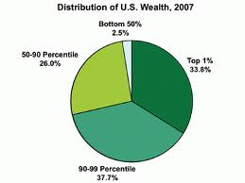
Fairness Test: Let’s Share a Pie! http://www.businessinsider.com/15-charts-about-wealth-and-inequality-in-america-2010-4#half-of-america-has-25-of-the-wealth-2

Slide 17
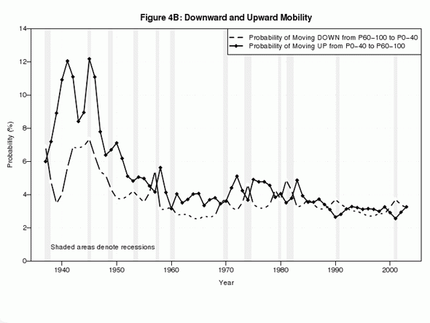
Social Mobility and Fairness Principle (Kopczuk and Saez, 2007)
Notes:
Berkeley and Columbia; http://docs.google.com/viewer?a=v&q=cache:hLQccPUpxxUJ:elsa.berkeley.edu/~saez/kopczuk-saez-songSSA07short.pdf+inequality+american+dream&hl=en&gl=us&pid=bl&srcid=ADGEESgcZu5DTakWjtUfRD9uHwtfiCYKn-gxPkgAyDLX1TY1moE6kZwPaJZNt0Pf-SsRP3uwx9keJ6yh9P0F57A4kl0VXI-jtt_3sONluLBHhQmKucl88SxWqvWLPtCy64NfrDsKRzWG&sig=AHIEtbQp0IonNfjbKStXejGlx-w525934Q

Slide 18
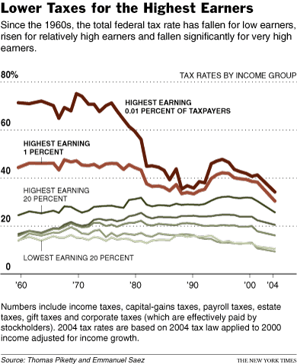
Fairness and Tax Policy
Historical Tax Rates by Income Group [NYTimes]
by Catherine Mulbrandon on November 3, 2007

Slide 19
Do the Wealthy Pay “their Fair Share”?
How do we measure this?
As a % of total Income?
Or gross tax payments?
Top 10% pay 71% of Federal Income Tax (Heritage Foundation)
Capital Gains compared to Marginal Tax Rates: The Warren Buffett Story

Slide 20
Income Inequality Correlates with many bad outcomes
Poorer Social Relations: Homicide, Imprisonment, Trust
Declining Human Capital: High School Drop Outs, Math and Literacy Scores, Teenage births, Social Mobility
Poorer Health: Drug Abuse, Infant Mortality, Mental Illness, Life Expectancy
Richard Wilkinson, TED Talk, http://www.ted.com/talks/richard_wilkinson.html

Slide 21
Myth 1 of Occupy: No Consistent Mission
Two things you will hear from almost every Occupy protestor
1) They oppose Crony Capitalism. Current system is rigged. This flies in the face of our faith in the American Dream. Wall Street is the symbol and source of this Disease.
2) Get the Corrosive Influence of Money out of Politics.
There are differences about what to do about these problems and individual Occupy encampments are working on proposals. The proposed solution is evolving.

Slide 22
Crony Capitalism
Subsidies and tax shelters favor Big Corporations that have lobbying influence over Small Business and Consumers. (30 of the Biggest Corporations paid No Taxes from 2008-2011)
Too Big To Fail and the End of Moral Hazard. The competitive force of capitalism economy requires that failed businesses fail. Home owners were allowed to fail; but the Banks that lent them money were not. This is not Fair and it is not Capitalist either.

Slide 23
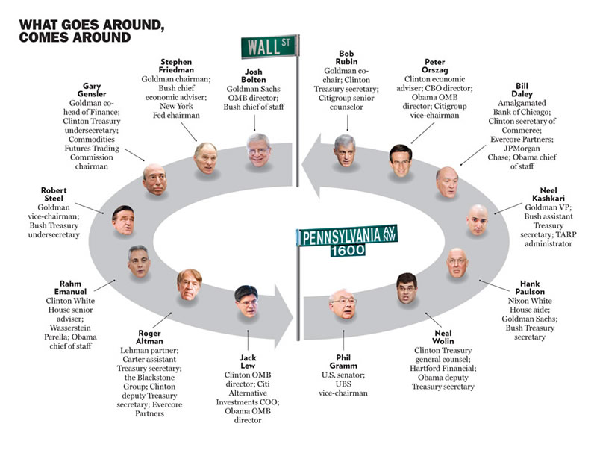
Campaign Finance and Lobbying Reform
End the Revolving Door between K Street and Wall Street
Newt Gingrich received over $1,60,000 in “consultation” fees after leaving Congress from Fannie Mae and Freddie Mac.

Slide 24
Occupy our Deficit
Tax the 1% more
Speculation Tax ; would raise revenue and dis-incentivize speculation; 800 B/decade
Allow Bush tax cuts to expire in 2012: 500 Billion/year
Stop Tax Haven Abuse Act: 100 B/year
Strategically reduce military spending. Base Defense Budget rose from 300 B in 2000 to nearly 700 B in 2011.
Social Security, Medicare, and Education should not suffer to pay for tax cuts that mostly benefited the 1% and a Bailout of Wall Street and Banks that benefited the 1%.

Slide 25
Occupy a Positive Economy
Bank Local: move our money to local banks and credit unions
Shop Local: shop local to support Main Street and stimulate local economy
Support policies that enable the 99% to pursue happiness:
  Education
  Health Care
  Safety Net for Seniors and Disabled

Slide 26
Conclusion: Is the American Dream Alive?
What is the American Dream and do we have faith in it?
The American Dream is predicated on Fair Play. What is necessary to make sure the game is fair, if not perfect?
Is the field of competition fair? Can we say that all men are created equal in America and that we all have a reasonable chance of pursuing our happiness?
What would Smith, Carnegie, and Rawls say?

Slide 27
Resources
Lifelong Monterey Republican speaks about Income Inequality: http://www.youtube.com/watch?v=u5K3D_g3FPo
Jamie Johnson, heir of Johnson and Johnson, does a video on the 1% and Income Inequality: http://www.youtube.com/watch?feature=player_embedded&v=HmlX3fLQrEc
7.7 TRILLION dollar loan from Fed to Big Banks: http://www.youtube.com/watch?v=oUpXDZFtEHw&sns=fb
http://www.ted.com/talks/richard_wilkinson.html
http://voicesofreasonblog.blogspot.com/2011/03/negating-proposition-income-inequality.html
http://voicesofreasonblog.blogspot.com/2011/03/affirming-proposition-income-inequality.html

